Slide 1
Collections
java.util package

Slide 2
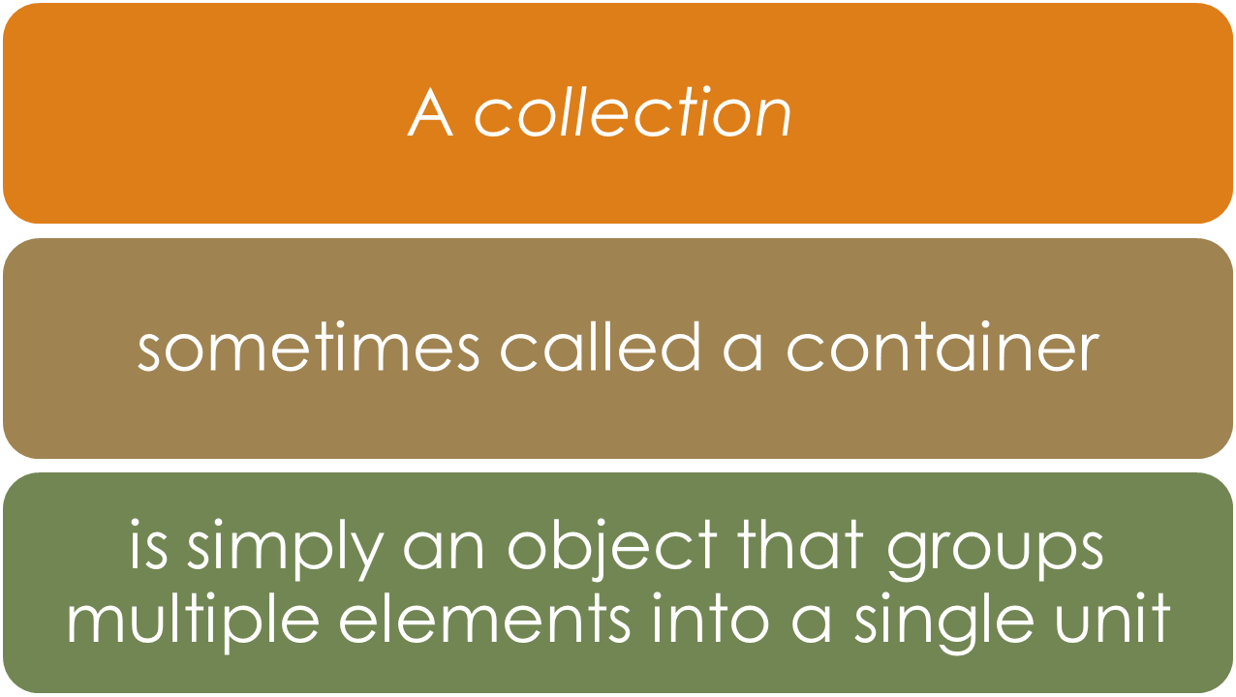
Introduction

Slide 3

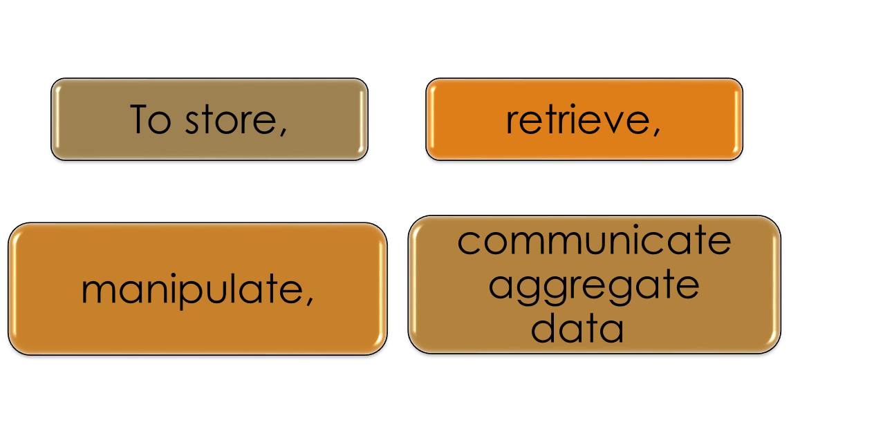

Slide 4
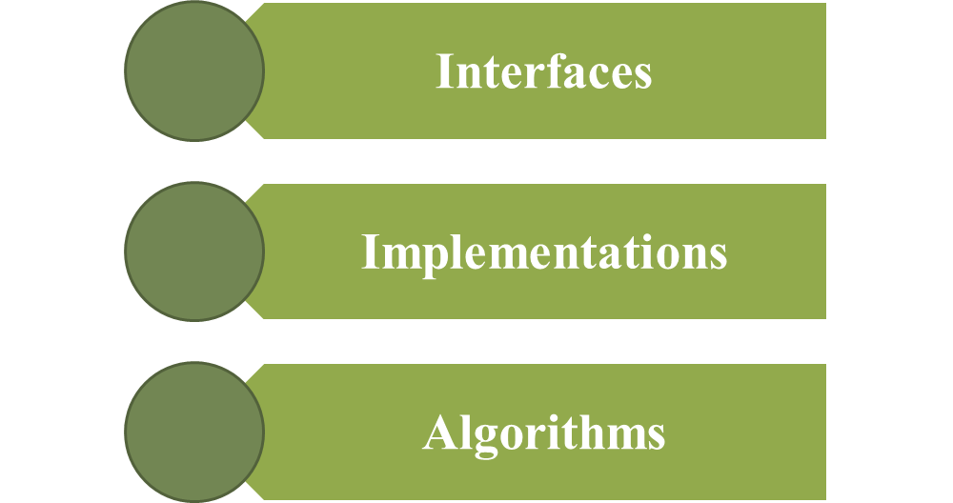
What Is a Collections Framework?
A collections framework is a unified architecture for representing and manipulating collections.
All collections frameworks contain the following
Notes:
Interfaces: These are abstract data types that represent collections. Interfaces allow collections to be manipulated independently of the details of their representation. In object-oriented languages, interfaces generally form a hierarchy.
Implementations: These are the concrete implementations of the collection interfaces. In essence, they are reusable data structures.
Algorithms: These are the methods that perform useful computations, such as searching and sorting, on objects that implement collection interfaces. The algorithms are said to be polymorphic: that is, the same method can be used on many different implementations of the appropriate collection interface. In essence, algorithms are reusable functionality.

Slide 5
Collections can dynamically grow in size and based on requirement the size can be increased or decreased
Collections can hold both homogeneous and heterogeneous elements
Collections can hold only Objects
Primitive types must be BOXED and added to Collection

Slide 6
Performance point of view collections are slower than Arrays
In-build Methods are available to operate on collection of Objects

Slide 7
Collection framework
A collection is an object that represent a group of objects
The collections framework standardizes the way in which these group of objects are handled by the java program
The collections framework enables collections to be manipulated independent of their implementation details

Slide 8
Collection framework
It reduces programming effort while increasing performance
The framework is based on more than a dozen collection interfaces.
It includes implementations of these interfaces and algorithms to manipulate them.

Slide 9
Advantages
Reduces programming effort by providing data structures and algorithms so you don't have to write them yourself.
Increases performance by providing high-performance implementations of data structures and algorithms. Because the various implementations of each interface are interchangeable, programs can be tuned by switching implementations.
Provides interoperability between unrelated APIs by establishing a common language to pass collections back and forth.
Reduces the effort required to learn APIs by requiring you to learn multiple ad hoc collection APIs.
Reduces the effort required to design and implement APIs by not requiring you to produce ad hoc collections APIs.
Fosters software reuse by providing a standard interface for collections and algorithms with which to manipulate them.

Slide 10
Consists of:
Collection interfaces. Represent different types of collections, such as sets, lists, and maps. These interfaces form the basis of the framework.
General-purpose implementations. Primary implementations of the collection interfaces.
Legacy implementations. The collection classes from earlier releases, Vector and Hashtable, were retrofitted to implement the collection interfaces.
Special-purpose implementations. Implementations designed for use in special situations. These implementations display nonstandard performance characteristics, usage restrictions, or behavior.
Concurrent implementations. Implementations designed for highly concurrent use.
Wrapper implementations. Add functionality, such as synchronization, to other implementations.
Convenience implementations. High-performance "mini-implementations" of the collection interfaces.

Slide 11
Consists of:
Abstract implementations. Partial implementations of the collection interfaces to facilitate custom implementations.
Algorithms. Static methods that perform useful functions on collections, such as sorting a list.
Infrastructure. Interfaces that provide essential support for the collection interfaces.
Array Utilities. Utility functions for arrays of primitive types and reference objects. Not, strictly speaking, a part of the collections framework, this feature was added to the Java platform at the same time as the collections framework and relies on some of the same infrastructure.

Slide 12
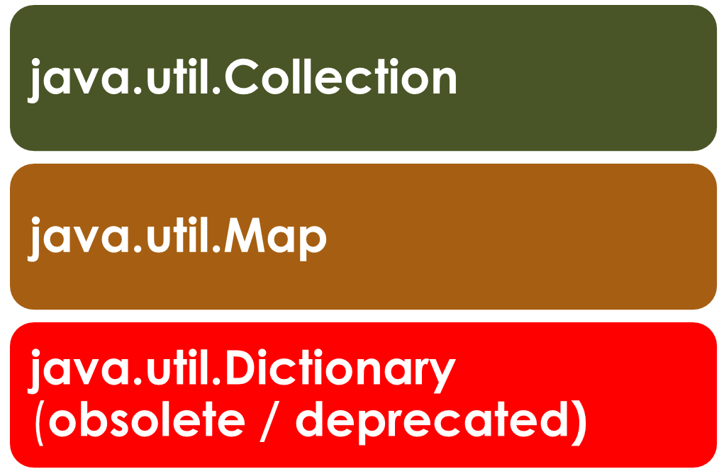
Collection Interfaces

Slide 13


Collection vs Map
A Collection is ordered in an index like 0,1,2,3..
Map - the objects are in memory unordered but for the computer's convenience it has a key to find the books, like in a library

Slide 14
Collection Implementations
Classes that implement the collection interfaces have names in the form of
<Implementation-style><Interface>.
Interface | HashTable | Resizable Array | Balanced Tree | Linked List | HashTable + Linked List
Set | HashSet |  | TreeSet |  | LinkedHashSet
List |  | ArrayList |  | LinkedList
Deque |  | ArrayDeque
Map | HashMap |  | TreeMap |  | LinkedHashMap

Slide 15
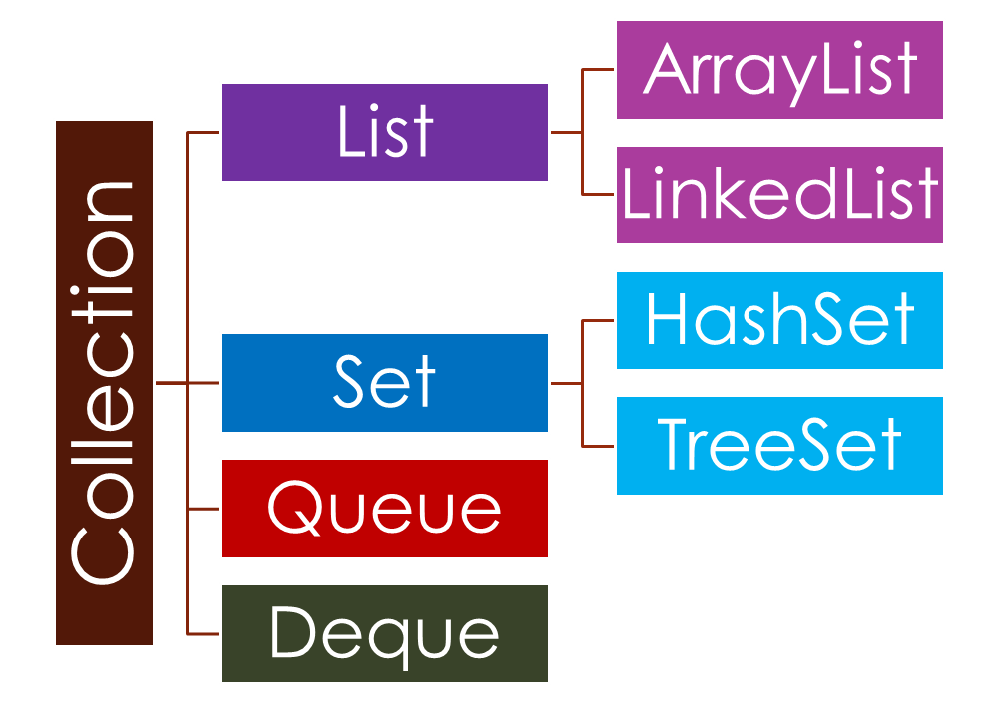
Collection

Slide 16
java.util.Collection
Java.util.List
java.util.Set
  java.util.SortedSet
    java.util.NavigableSet
java.util.Queue
  java.util.concurrent.BlockingQueue
    java.util.concurrent.TransferQueue
java.util.Deque
  java.util.concurrent.BlockingDeque

Slide 17
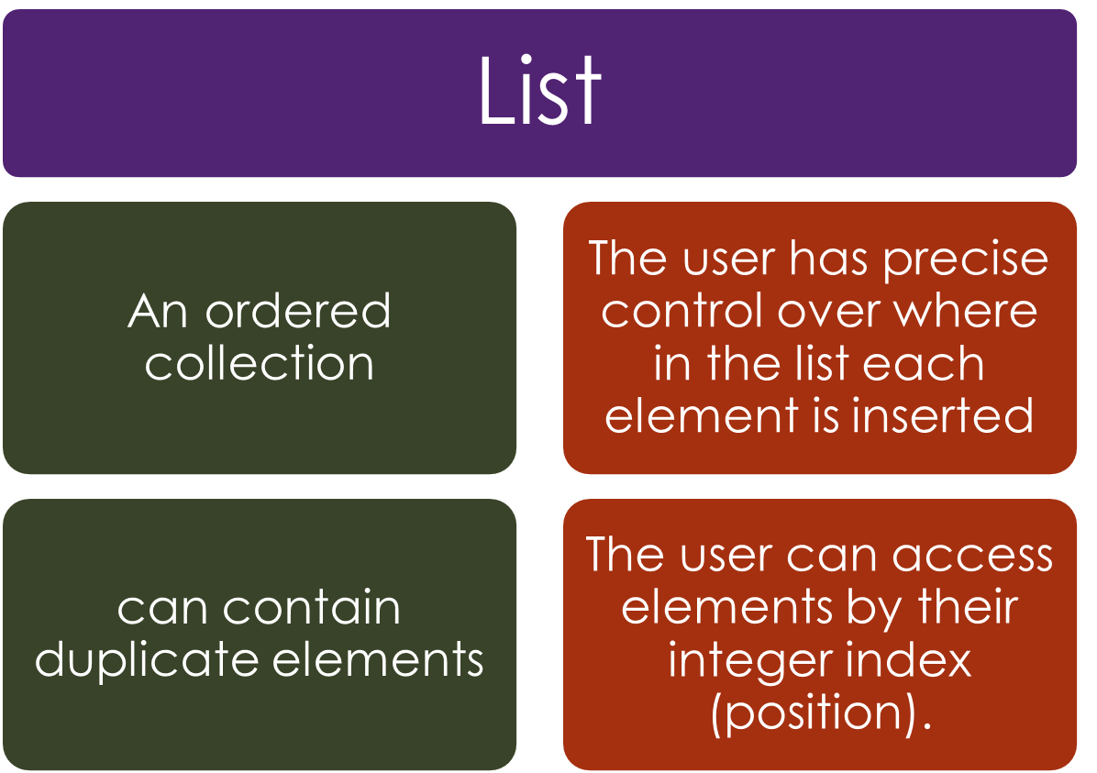

Slide 18
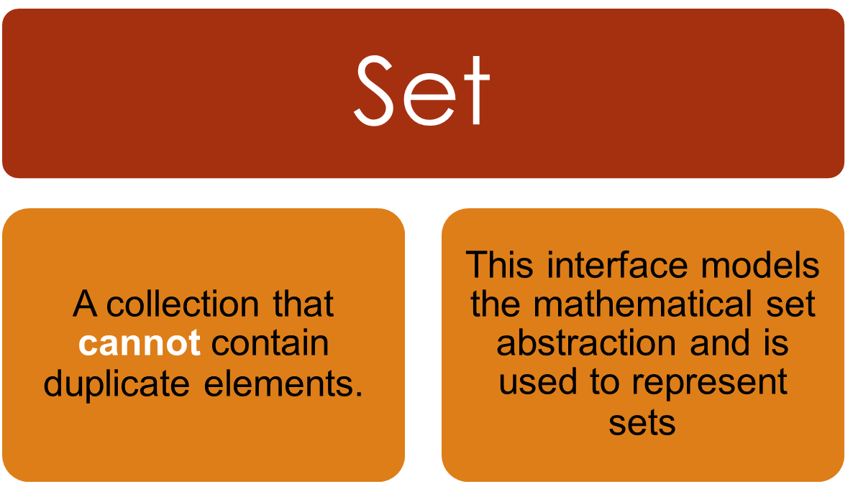
A set may be used to represent sets,
the courses making up a student's schedule, or the processes running on a machine

Slide 19
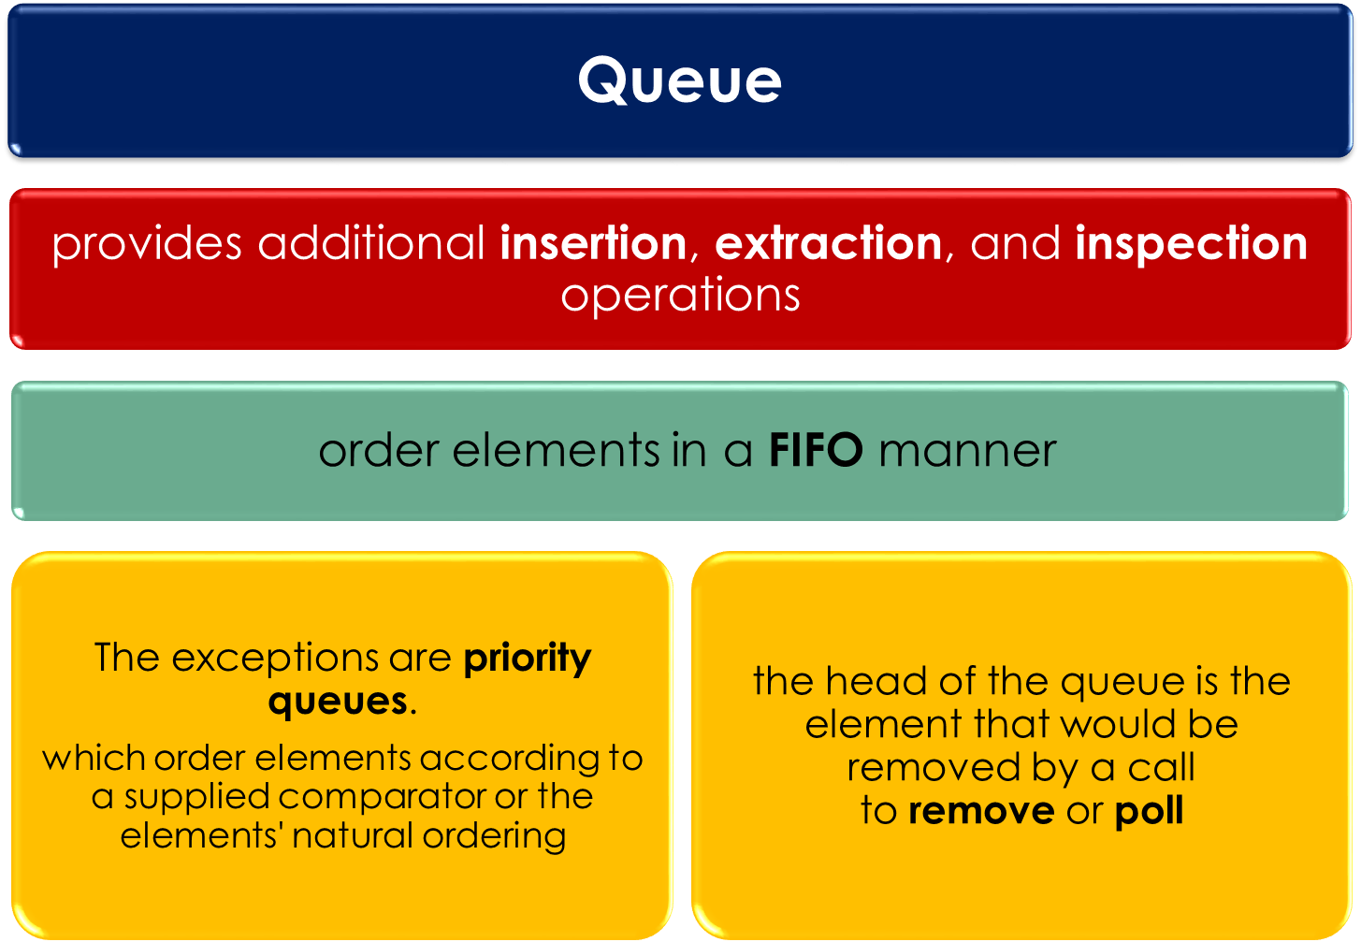
Notes:
In a FIFO queue, all new elements are inserted at the tail of the queue.
Other kinds of queues may use different placement rules.
Every Queue implementation must specify its ordering properties.

Slide 20


Slide 21
More Collection Interfaces
Interfaces Description
Collection Enables you to work with group of objects
Comparator Briefs how two objects are compared
Iterator, Enumerate the objects within a collection.
ListIterator

Slide 22
Collection
AbstractCollection
Set
List
Extends collection to handle sequences (list of objects)
Extends collection to handle sets, must contain unique elements

Slide 23
Collection
List
implement
implement
extends
AbstractCollection
AbstractList
extends
extends
Abstract
SequentialList
ArrayList
extends
LinkedList

Slide 24
Collection
implement
extends
AbstractCollection
Set
extends
implement
AbstractSet
extends
SortedSet
extends
extends
HashSet
TreeSet

Slide 25
Collection Interface
boolean add (Object ob) - adds object to collection
- returns false if collection does not allow duplication
void clear () - removes all elements from collection
boolean contains (Object o)
boolean isEmpty ()
Iterator iterator () - returns an Iterator object
boolean remove (Object o)
boolean removeAll (collection c)

Slide 26
java.util.List << Interface >>
extends from java.util.Collection
Elements can be inserted or accessed by their position in the list, using zero-based index.
A list may contain duplicate elements.

Slide 27
java.util.List
void add (int index, Object o)
Object get (int index)
int indexOf (Object o)
int lastIndexOf (object o)
ListIterator listIterator () - returns an iterator to the start of invoking list.
ListIterator listIterator (int index)
Object remove (int index)
Object set(int index, Object o)
List subList(int start, int end)
    - returns a list that includes elements from start to end.

Slide 28
ArrayList implements List
This class provides methods to manipulate the size of the array that is used internally to store the list.
This class is roughly equivalent to Vector, except that it is unsynchronized.
Each ArrayList instance has a capacity. It is at-least as large as the list size.
As elements are added to an ArrayList, its capacity grows automatically.
Duplicate values can be added to an ArrayList

Slide 29
An application can increase the capacity of an ArrayList instance before adding a large number of elements using the ensureCapacity() operation.
This may reduce the amount of incremental reallocation.

Slide 30
java.util.Iterator
public abstract boolean hasNext();
public abstract java.lang.Object next();
public abstract void remove();

Slide 31
Using an Iterator
An iterator is an object that enables a programmer to traverse a container ( a collection ).
Generates a series of objects, one at a time.
Successive calls to the hasNext() method return successive Object of the series.
Obtain an iterator to the start of the collection by calling the collection iterator() method.
Set up a loop that makes a call to hasNext(). Have the loop iterate as long as hasNext() return true.
Within the loop, obtain each element by calling next().

Slide 32
Demo
ArrayList and iterator

Slide 33
Note that ArrayList implementation is not synchronized.
If multiple threads access an ArrayList instance concurrently, and at least one of the threads modifies the list structurally, it must be synchronized externally.
ArrayList arraylist = new ArrayList();
List synchedlist = java.util.Collections.synchronizedList(al);
synchedlist.add(“Hello”);

Slide 34
LinkedList
The LinkedList class extends AbstractSequentialList and
implements the List interface.
LinkedList class provides uniformly named methods to get, remove and insert an element at the beginning and end of the list.
These operations allow linked lists to be used as a stack, queue, or double-ended queue.
The class implements the Deque interface, providing first-in-first-out queue operations for add, poll, along with other stack and deque operations.
Note that this implementation is not synchronized

Slide 35
LinkedList
Methods.
Void addFirst(Object obj)
void addLast(Object obj)
void getFirst()
void getLast()
void removeFirst()
void removeLast()

Slide 36
Object Ordering
A List reference “objlist” may be sorted as follows.
  Collections.sort(objlist);
If the List consists of String elements, it will be sorted into alphabetical order.
If it consists of Date elements, it will be sorted into chronological order.
String and Date both implement the Comparable interface.
Comparable implementations provide a natural ordering for a class,.

Slide 37
Classes Implementing Comparable
Class | Natural Ordering
Byte | Signed numerical
Character | Unsigned numerical
Long | Signed numerical
Integer | Signed numerical
Short | Signed numerical
Double | Signed numerical
Float | Signed numerical
BigInteger | Signed numerical
BigDecimal | Signed numerical
Boolean | Boolean.FALSE < Boolean.TRUE
File | System-dependent lexicographic on path name
String | Lexicographic
Date | Chronological
CollationKey | Locale-specific lexicographic

Slide 38
Set
A collection that contains no duplicate elements.
More formally, sets contain no pair of elements e1 and e2 such that e1.equals (e2), and at most one null element.
Set extends Collection. SortedSet extends Set
Implementation of SET
  HashSet <<class>>
  TreeSet <<class>>

Slide 39
HashSet
HashSet implements Set interface.
It creates a collection that uses a HashTable for storage.
In hashing the informational content, a key is used to determine unique value, by calling its hashCode.
The hashcode is then used as Index at which the data associated with the key is stored.
A HashSet provides fast access to unique values only. (there are no keys because it is not a mapping, it's just the values).
Notes:
HashSet values are unordered, which makes it faster than the TreeSet to work with small sets of data,
In a TreeSet the values are ordered.

Slide 40
Demo
Hash Set

Slide 41
The TreeSet Class.
TreeSet provides an implementation of the Set interface that uses a tree for storage.
Objects are stored in sorted, ascending order, which makes the TreeSet an excellent choice when storing large amounts of sorted information that must be found quickly.

Slide 42
The TreeSet Class.
For an empty TreeSet a null value can be inserted as first element . But after inserting that first value if we are trying to insert any other objects then we will get NullPointerException.
when some elements are there in the tree then before inserting any object it compares the new object to the existing ones by the compareTo() method and decides where to put the new object.
So when inserting null the compareTo() method internally throws NullPointerException.

Slide 43
import java.util.TreeSet;
class Treesetdemo{
  public static void main(String args[])
  {
    TreeSet ts=new TreeSet();
    ts.add(“C”);ts.add(“A”); ts.add(“B”); ts.add(“E”); ts.add(“F”); ts.add(“D”);
    System.out.println(ts);
  }
}
output : [A, B, C, D, E, F]

Slide 44
java.util.Map
Map is an object that maps keys to values.
A Map cannot contain duplicate keys.
Each key can map to at most one value.
MAP is not a Collection (MAP does not implement the Collection interface) .

Slide 45
java.util.Map
java.util.SortedMap
java.util.NavigableMap
java.util.concurrent.ConcurrentMap
java.util.concurrent.ConcurrentNavigableMap

Slide 46
java.util.Map not a collection interface
boolean containsKey (java.lang.Object);
Object get (java.lang.Object);
Object put (java.lang.Object , java.lang.Object);
Object remove (java.lang.Object);
Void clear();
Set keySet(); // for iteration
Set entrySet();

Slide 47
Collection vs Map
Map - the objects are in memory unordered but for the computer's convenience it has a key to find the books, like in a library
A Collection is ordered in an index like 0,1,2,3..

Slide 48
HashMap
HashMap implements Map interface.
A HashMap provides fast access to a mapping from a unique key to a value.
Keys are unordered, which makes it faster than the TreeMap, where the keys are ordered.
HashMap stores the data (values or objects) in key-value pairs .
Multiple Null values can be stored
HashMap is not a collection.

Slide 49
HashMap Demo

Slide 50
abstract class java.util.Dictionary not a Collection or Map interface
NOTE: This class is obsolete since JDK 1.0.
New implementations should implement the Map interface, rather than extending this class.
Enumeration keys ();
Enumeration elements ();
Object get (java.lang.Object);
Object put (java.lang.Object, java.lang.Object);
Object remove (java.lang.Object);

Slide 51
Hashtable
public class Hashtable extends Dictionary implements Map, Cloneable, Serializable.
Any non-null object can be used as a key or as a value. To successfully store and retrieve objects from a Hashtable, the object used as a key must implement the hashCode method and the equals method. An instance of Hashtable has two parameters that affect its performance: initial capacity and load factor.

Slide 52
Differences between
HashMap and Hashtable
1. Hashtable is synchronized, whereas HashMap is not. This makes HashMap better for non-threaded applications, as unsynchronized Objects typically perform better than synchronized ones.
2. Hashtable does not allow null keys or values.
HashMap allows one null key and any number of null values
3. Hashtable is deprecated and does not support new features

Slide 53
Differences between
HashMap and Hashtable
One of HashMap's subclasses is LinkedHashMap, so in the event that you'd want predictable iteration order (which is insertion order by default), you could easily swap out the HashMap for a LinkedHashMap.
This wouldn't be as easy if you were using Hashtable.

Slide 54
java.util.Properties extends java.util.Hashtable
The Properties class represents a persistent set of properties.
The Properties can be saved to a stream or loaded from a stream.
Each key and its corresponding value in the property list is a String.
Because Properties inherits from Hashtable, the put() and putAll() methods can be applied to a Properties object. Their use is strongly discouraged as they allow the caller to insert entries whose keys or values are not Strings.
The setProperty method should be used instead.
This class is thread-safe: multiple threads can share a single Properties object without the need for external synchronization.

Slide 55
Vector

Slide 56
java.util.Vector
extends java.util.AbstractList implements java.util.List.
It is similar to Arraylist ( dynamic array) but with two difference.
  Vector is Synchronised and
  Contains many legacy methods that are not part of the collections frame work.
  Vector can be Iterated and also Enumerated.
Notes:
Ex:
import java.util.*;
class vectordemo
{
public static void main(String args[])
{
//Initial size is set to 3 and made to increment by 2
Vector v=new Vector (3,2)
System.out.println(“Initial size :”+v.size);
System.out.println(“Initial capacity :”+v.capacity);
v.addElement(new Integer(1));
v.addElement(new Integer(2));
v.addElement(new Integer(3));
v.addElement(new Integer(4));
System.out.println(“capacity after four additions :”+v.capacity);
}

Slide 57
java.util.Enumeration
boolean hasMoreElements();
java.lang.Object nextElement();

Slide 58


